Slide 1
Flight reservation

Slide 2
Technologies use
Html
Css
TypeScript
Bootstrap
Node JS
Angular framework

Slide 3
First create angular project using
Install node js
Check node js version using command as node --version
Check npm command version using command as npm --version
Then install ng command using npm install –g @angular/cli
Then create the project using command as
ng new flight-reservation
Routing : yes
Styling : css

Slide 4
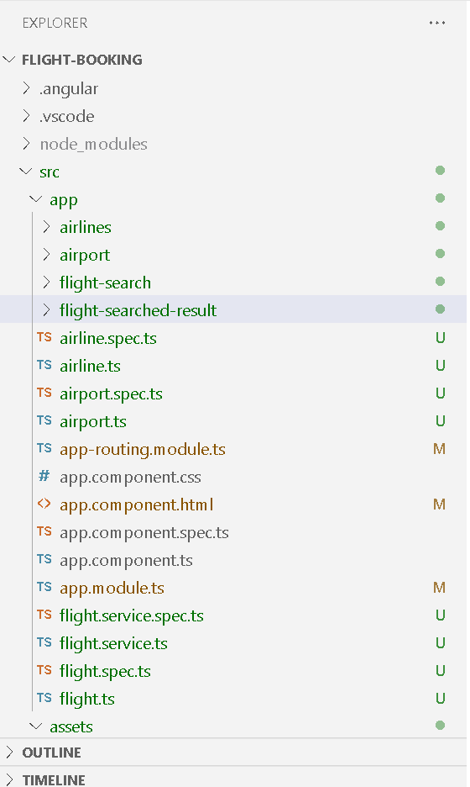
The project structure

Slide 5
Short description
Component created : ng g c airline
Airline
Airport
Flight-search
Flight-search-result
Service : ng g s flightservic
FlightService
Model : ng g class flights
Flights

Slide 6
To run the project
First run the command as npm install inside a : flight-booking folder.
Then run the command as ng serve
After compiled program successfully open the browser and write the URL as http://localhost:4200

Slide 8
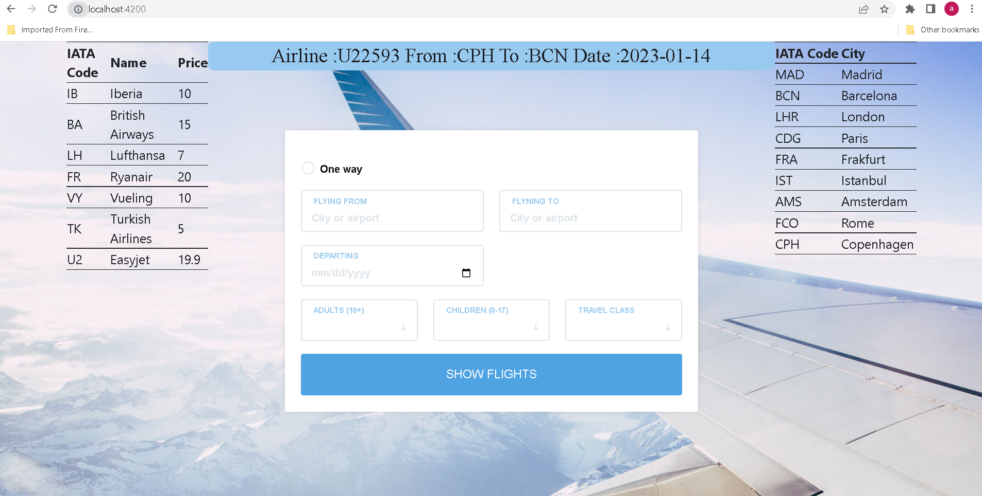
Landing screen

Slide 9
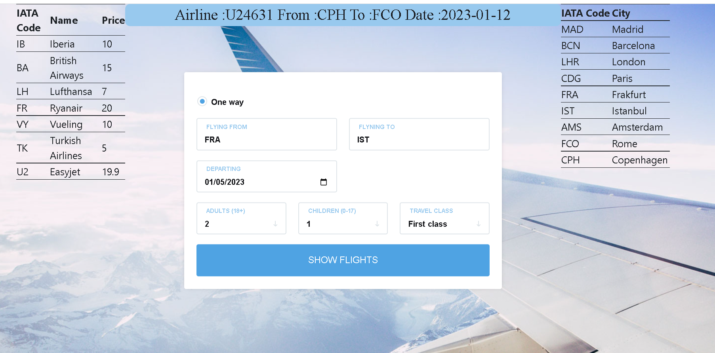
We can search the flight

Slide 10
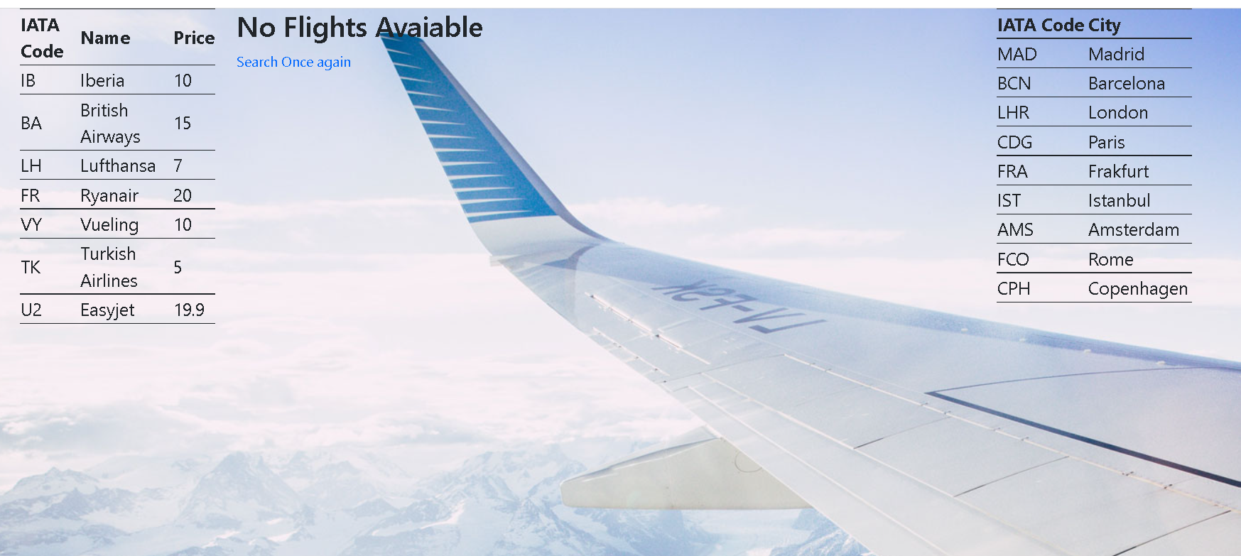
If there is not flight available then we will get the result as

Slide 11
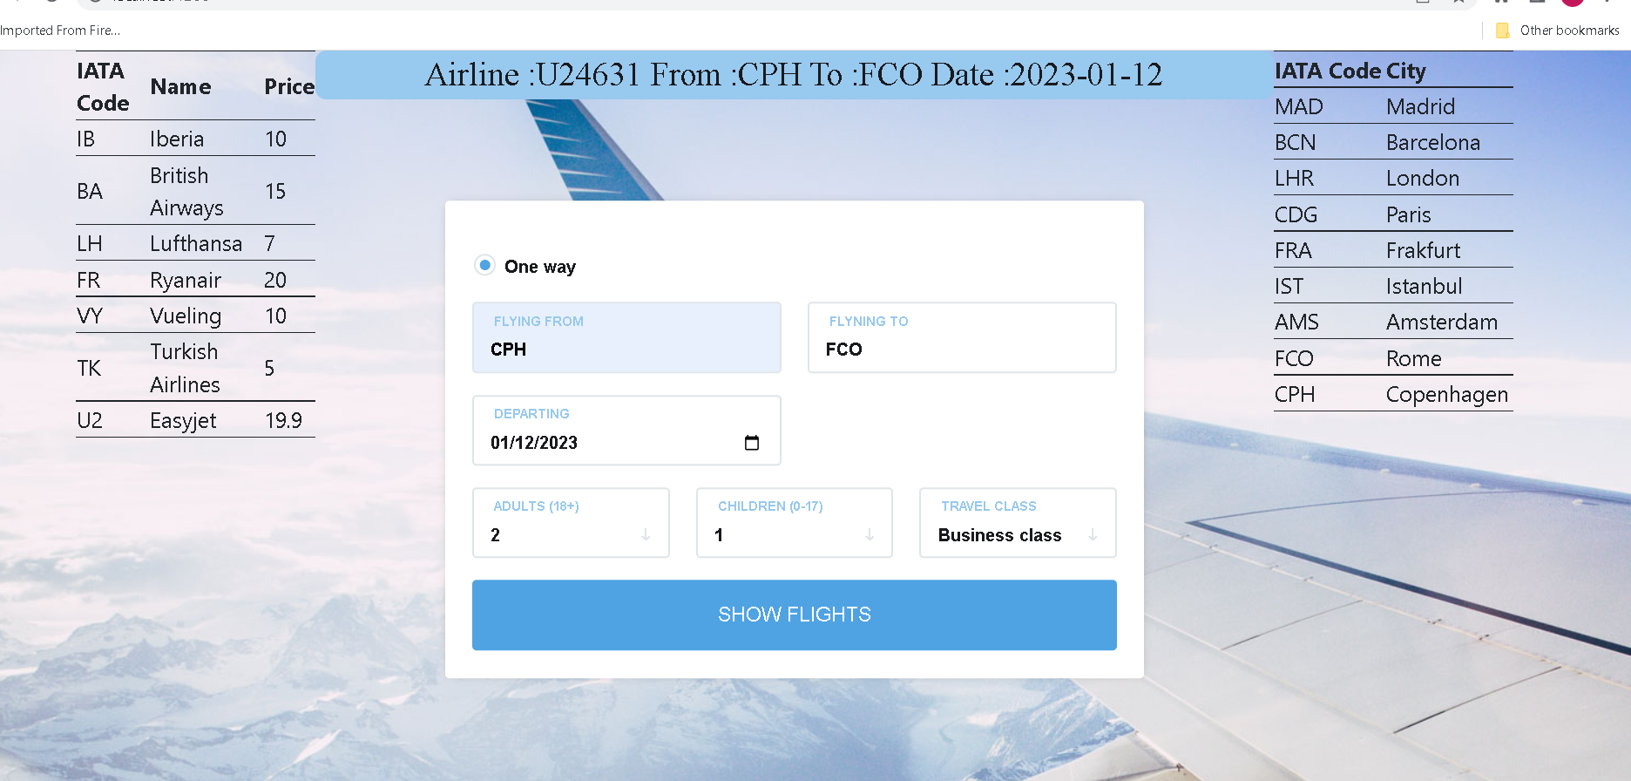
Search with available flight

Slide 12
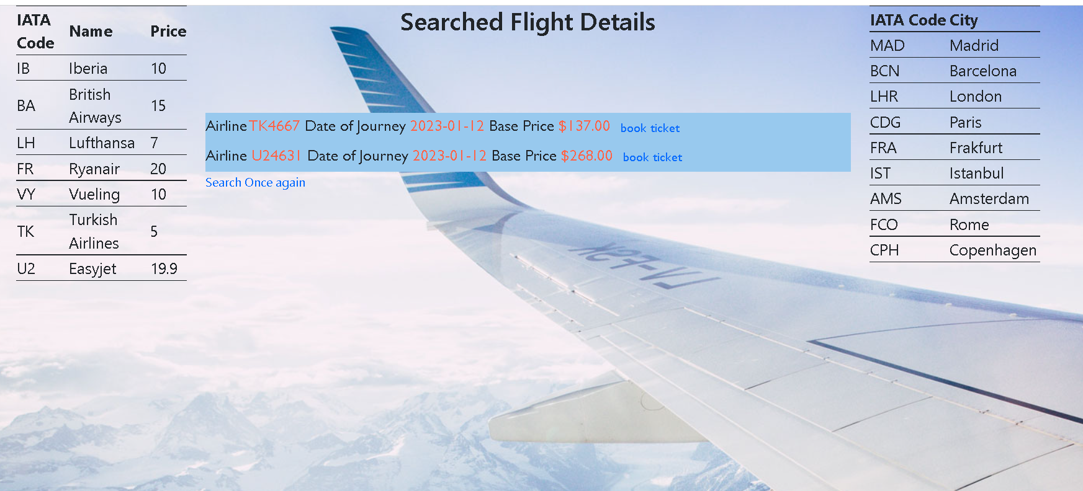
If flight are available then we will get the result as

Slide 13
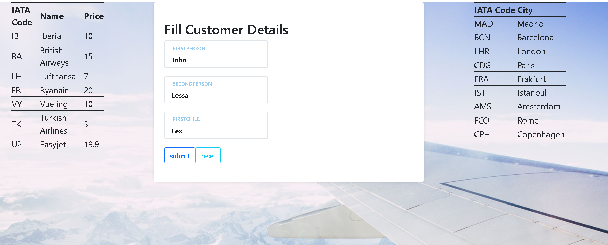
After provided customer details

Slide 14
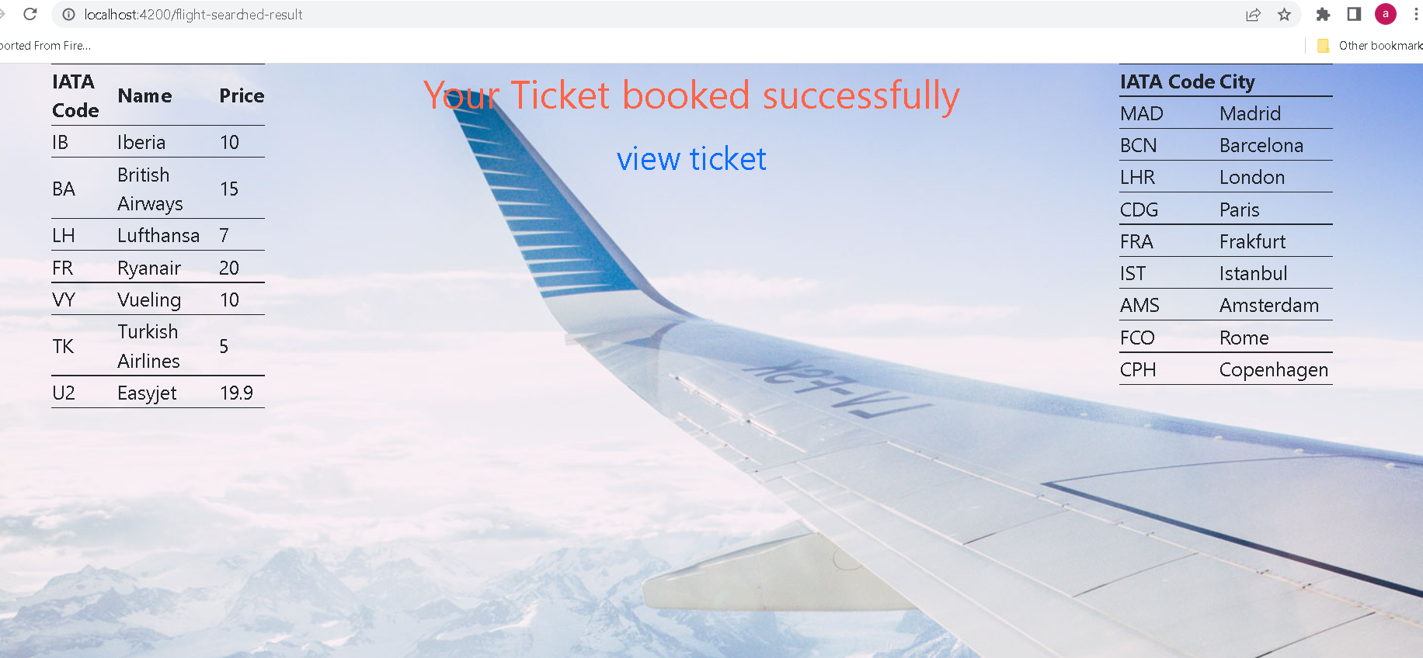
It book the flight

Slide 15

To view the ticket we need to click on hyperlink

Slide 16
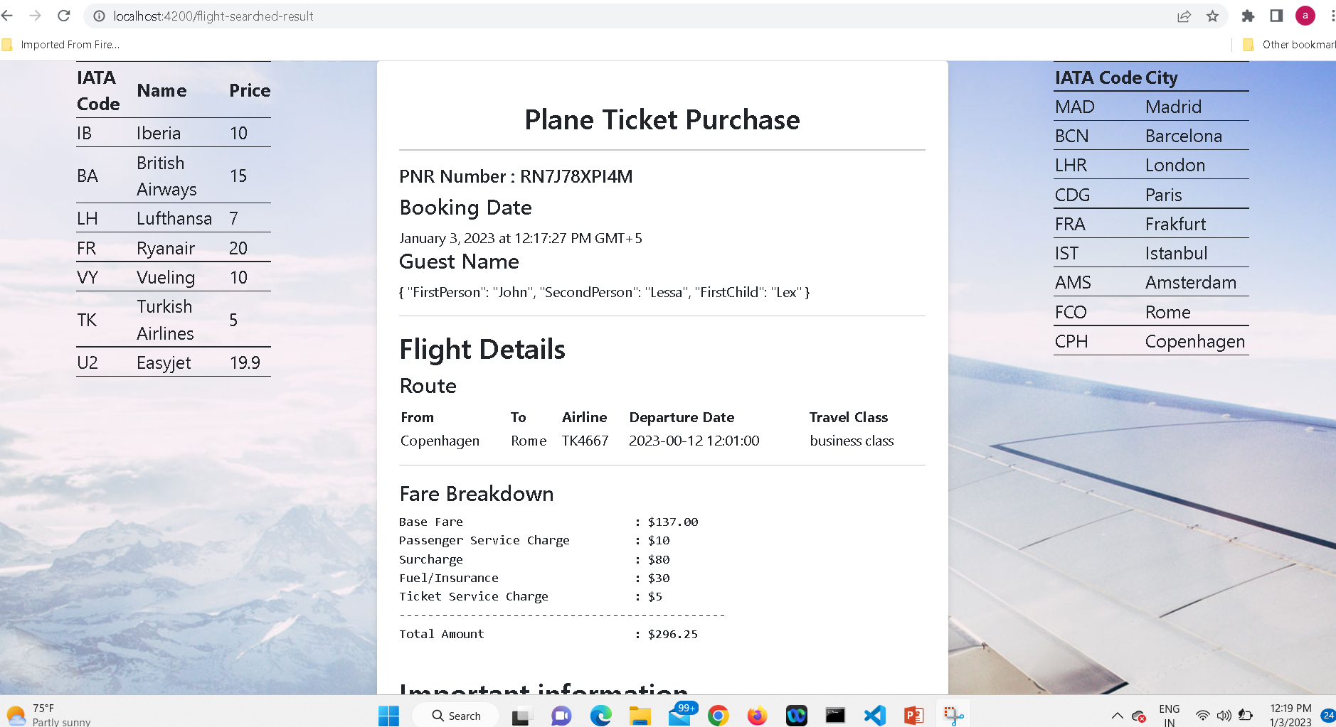
Booked the ticket

Slide 17
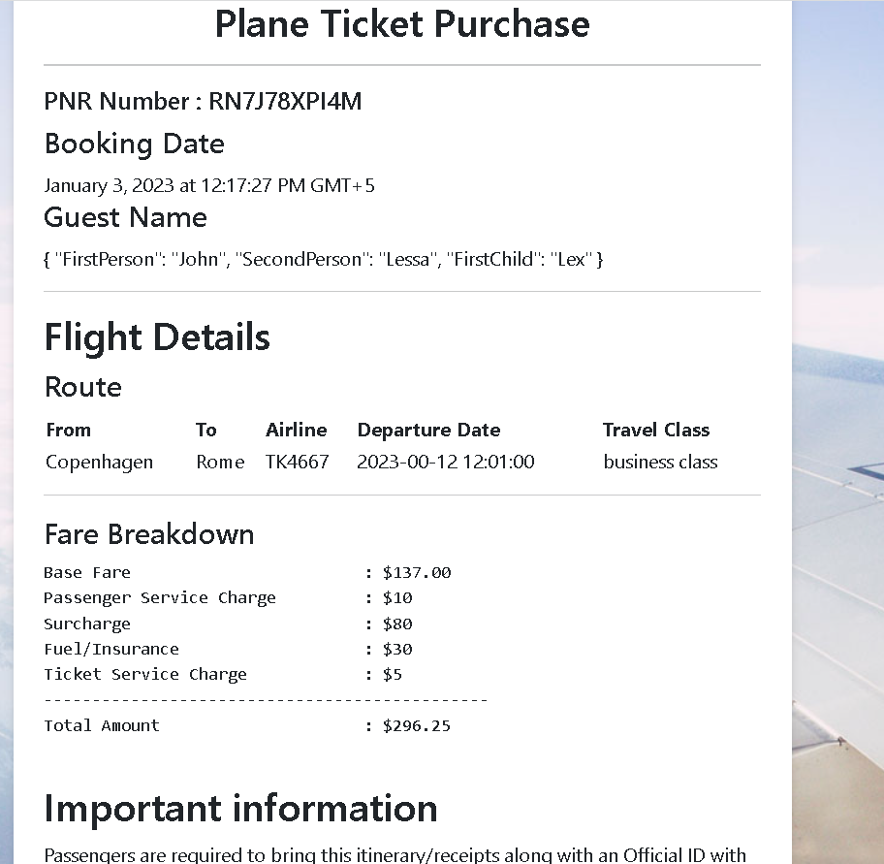
You can view the ticket in browser

Slide 18
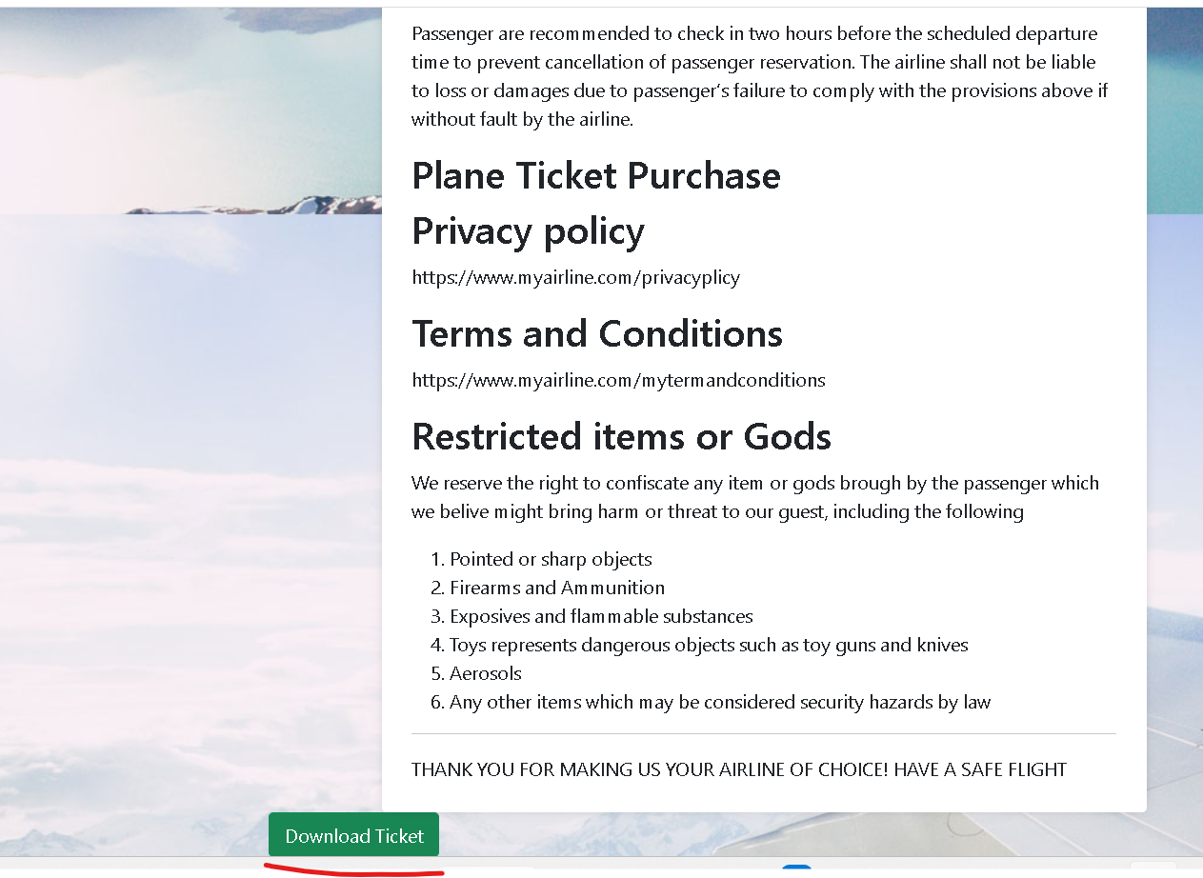
You can download the ticket by clicking on button as

Slide 19
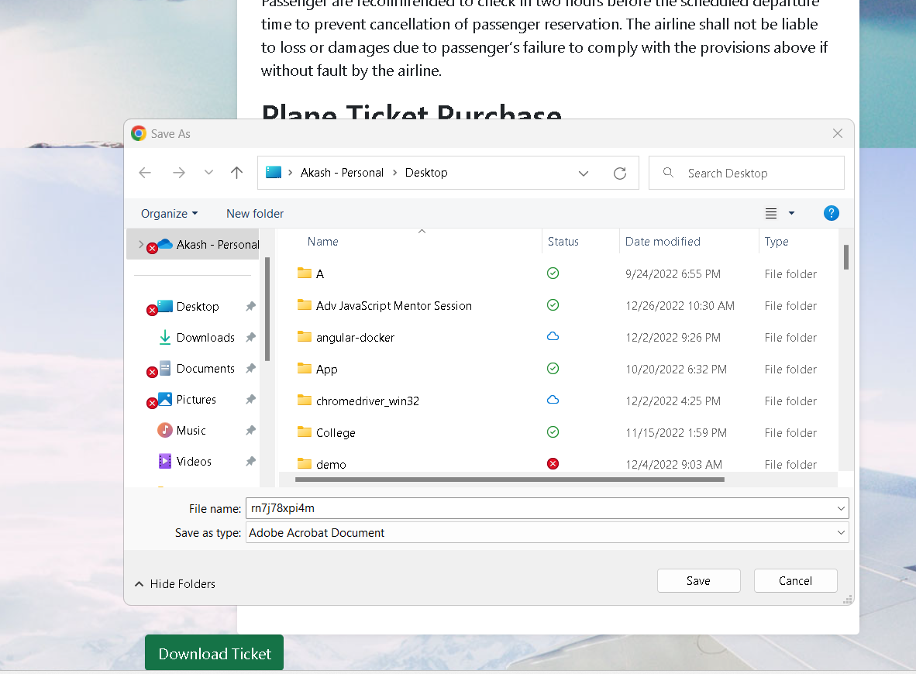
The ticket save with auto random pnr number

Slide 20
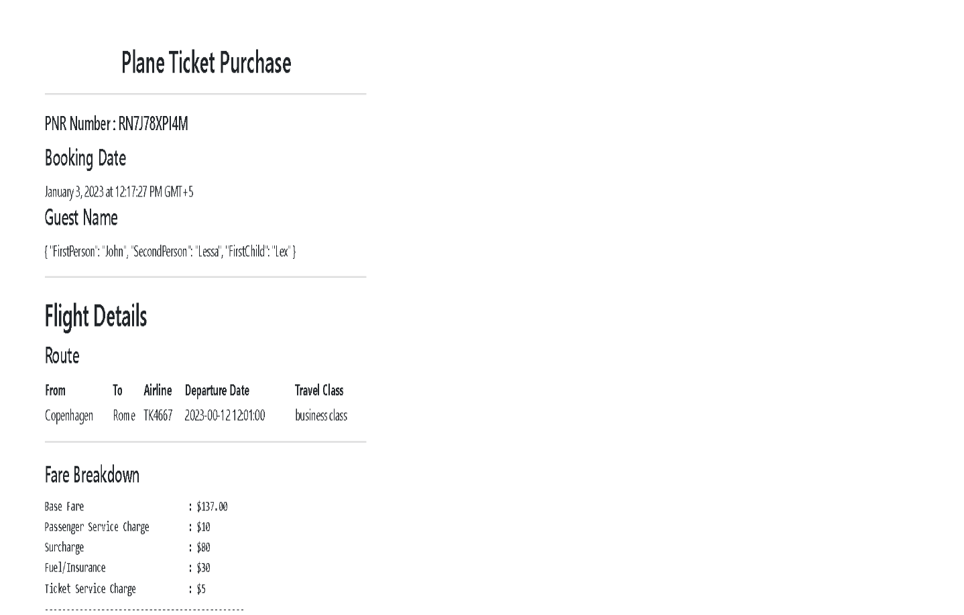
View the ticket in pdf format.

Slide 21
